Slide 1
Heat Metering Regulation
Compliance - the first step towards a Heat Metering & Billing strategy
Gearoid Lane
CEO
15th September 2015

Slide 2
AgilityEco provides a range of professional services in energy efficiency and low carbon arena
OUR SERVICES
LOW CARBON FINANCING (including ECO)
GREEN DEAL
ENERGY CONSULTANCY
LOW CARBON PROJECT DELIVERY
SURVEYING
ECO
ECO carbon delivery
ECO compliance
ECO policy advice
Non ECO
Solar and communal heat financing
FIT/RHI
Other bespoke funding e.g. GDC
Accredited Green Deal Provider
Green Deal Finance provider
Design customer facing GD propositions
Low carbon business strategy
Bespoke consulting work
Project design and financing
R&D projects
Specialist procurement advice
Housing stock assessment
Feasibility, design and specification
Carbon calculation
Manage full end-to-end project delivery: - Insulation - Solar - Communal Heat - Lighting
Extensive installer and technician partner network
Accredited GDAO
Run by RICS /Chartered Surveyor
Surveying services: for domestic and commercial clients - EPCs, DECs, GDARs, etc - TM - Stock assessment
+35k surveys p/a
OUR CLIENTS
Energy Companies
Local Authorities/
Social Landlords
Installers
M&E Specialists
Private Landlords
Trade Bodies
Finance/ Banking
Government Departments
Building Service Companies
Estate Agents

Slide 3
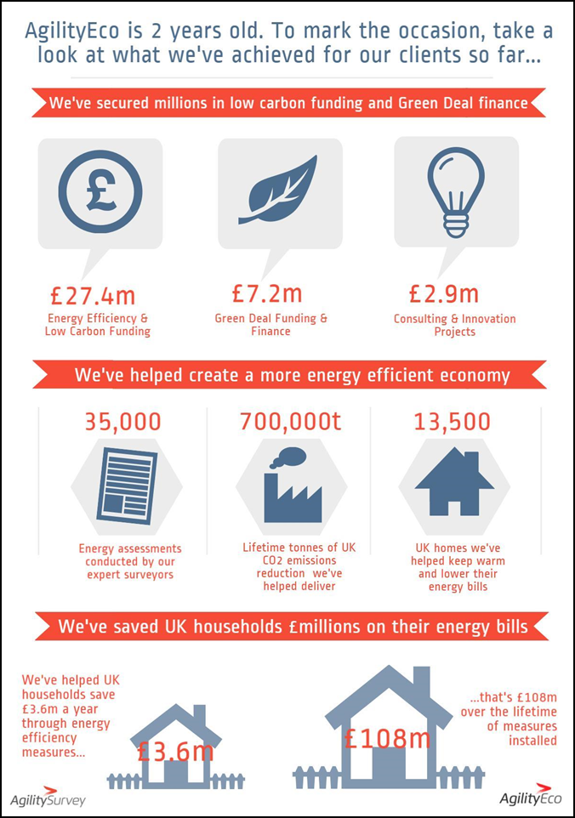
Since our company was launched 2 years ago we’ve delivered impressive results for clients

Slide 4
Heat Metering and Billing is a better, more modern solution for residents…
“Heat with Rent” is unfair:
Smearing energy charges across residents as a service charge is outdated and unfair
As energy prices rise, this will become an increasing “bone of contention” for residents
HM&B incentivises efficiency:
Flat rate service charges provide no incentive to residents to use energy efficiently – this can lead to profligate use of energy
Those that use heat efficiently see others wasting energy and increasing their service charges
By combining HM&B retrofit with improved controls, efficient behaviours can be enabled and rewarded, and with improved resident comfort
HM&B enables transparency:
Often there is little/no reconciliation between the energy purchased and what is subsequently recharged to tenants
HM&B is in line with your duty of care:
Landlords are keen to help where possible to reduce the burden of high energy bills, particularly for vulnerable residents
As part of a wider strategy, HM&B can help reduce bills for residents

Slide 5
…and there may be a good case for treating HM&B compliance as a strategic opportunity for retrofit
EU Legislation will force change:
Eventually all dwellings served by communal & district heating will be required to have individual heat meters.
Beginning the retrofit process now enables a sensible, phased programme
Technology is making metering and billing easier:
Costs of heat metering are reducing
Reliability and security are increasing
Modern “pay as you go” metering is resident-friendly and eliminates energy debt
The day-to-day operation of HM&B service can be outsourced:
High quality service providers exist today
Over 100,000 households now have HM&B
By setting appropriate KPIs, you can ensure high quality resident service
Better cost recovery and reduced energy waste save you money:
Transparency of energy costs and resident charges enables full pass through
Better cost recovery can underpin the business case for HM&B
This is reinforced by energy cost savings from less waste

Slide 6
The scope of the HM&B Regulations is wide and almost all communally heated buildings are covered
The HNMB Regulation relates to: Organisations who supply and charge for the supply of heating, cooling or hot water to a final customer, through either:
(a) Communal heating; or
(b) A district heat network;
of any size (2 dwellings served by single heat/cooling source would be in scope)
IN SCOPE
OUT OF SCOPE
A rented accommodation with a single heat source supplying multiple dwellings
Sheltered and social housing
Sub-let space such as fitness centres or restaurants in hotels or third party dry cleaners in supermarkets
University halls of residence
Residential care homes
Shared offices
Shopping centres
Hotel rooms except where they are being used as dwellings
Rental of a squash court at a sports centre
Prisons
Nursing homes where all services are provided communally
Industrial site where heat is generated and distributed within the site as part of the industrial process

Slide 7
There’s a phased approach to compliance, and deadlines are tight despite the suspension announced
Heat Metering Timeline
Dec 2015
Dec 2016
Phase 1
Assess All Heating Systems
Phase 2
Feasibility and Options Appraisal
Phase 3
Implement Heat Metering Actions
Phase 4
Demand Management, Reduction and Review
2015
2016
2020
2020
2020
2020
Duty to Notify
Duty to Install
4 Year Review
Full review of Communal and District Heating Systems
Fully assess technical and economic feasibility
Undertake a review every 4 years
All new builds must have heat metering
7

Slide 8
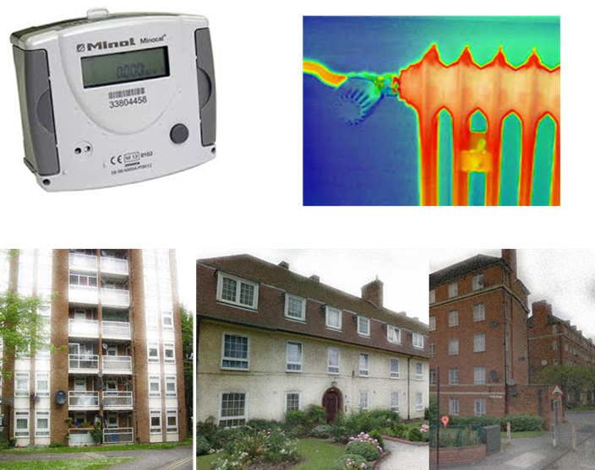
We recommend a rigorous project managed approach to the compliance journey
Initial project scoping: create a project plan and timeline. Assign responsibilities
Portfolio assessment: undertake desktop work to gather necessary data: billing data, stock records, etc
Site technical surveys: visit all sites to validate data provided and collect required property information
Commercial feasibility: assess every site using the tools provided by NMRO, to determine if heat metering is required
NMRO submission: collate all required data and send to NMRO before the deadline
Data transfer: update asset register using survey data collected
Project outcomes: assess key findings and prioritise sites for HM&B retrofit
Heat metering strategy: develop a longer term heat metering strategy

Slide 9
Our work with several landlords on HM&B compliance tells us that preparation is key…
Preparation
Identify where Housing Stock Data needs to be supplemented
Preparation for Stock Assessment and Data Collection
Work out what’s in scope
Identify all available stock data, but generally this is insufficient and patchy
Crucial to identify the number of properties served by each communal/district heating system
Be mindful of complex buildings (town halls, offices, extra buildings served by system, etc)
Is heat distributed by low temperature hot water, below 90 degrees
Heating capacity, heat generated, heat supplied
Types of heat emitters
Number of radiators per dwelling
Single point entry
Are there time controls, temperature controls and /or TRVs?
Landlord energy bills for past 12 months
Access to boiler rooms and sample of dwellings is essential for all sites
Support from RLO or someone with local knowledge important
Use this opportunity to gather other useful site data, EPC’s, stock condition, etc
Strongly recommend that photographic evidence is taken to support NMRO submission
All boiler rooms and a sample of dwellings/units will require a site visit

Slide 10
…and that a rigorous approach to the compliance project can save you time and money
Collecting Housing Stock Data
Completing the NMRO templates
Final submission and Next Steps
Ensure ALL data is collected at the initial site visit
For larger projects utilise software to auto-populate NMRO spreadsheet with site data (e.g. AgilityEco bespoke software)
Additional information on energy bills /consumption will be needed
Different data sets required for validation tool and final submission document
Multiple network notification form can be used for larger projects
Detailed billing data required for this stage:
Energy price charge
Bill calculation
Heat/Hot Water capacity generated and supplied
Ensure all documentation and photos are retained
Utilise this exercise to validate and update stock records – remember you will need the data again!
Using submission data to develop a prioritisation plan for building point entry/heat metering
Develop a broader heat metering and billing strategy for your housing stock
Ensure you have a clear understanding of all data collection requirements to avoid multiple site visits

Slide 11
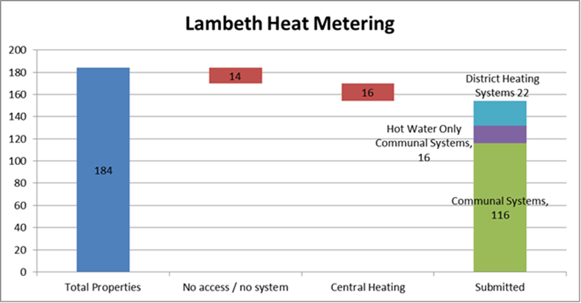
Lambeth’s HM&B compliance shows that, with good planning, the exercise can be painless
Heat networks serving over 5,900 properties were assessed for Lambeth Council
185 individual communal/district heating plans were surveyed and assessed during a 3 week period
Technical / economically viability assessments completed on 155 sites - none were deemed viable!
NMRO submission documents filed before original deadline of 30th April
Lambeth Project Timeline
MARCH 2015
APRIL 2015
Project Scoping
Project Planning
Site Visits
Data Collation and validation
NMRO Data Submission

Slide 12
AgilityEco can assist throughout the compliance journey and developing your HM&B strategy
Initial Assessment of Housing Stock Data
Determine which Properties are in Scope
Identify Data Collection Requirements – site and client
Prioritisation of regulatory metering installations
Complete NMRO Submission – dealing with any queries
Organise Site Visits – Customer Liaison
Complete NMRO Templates
Using bespoke software collate and validate site data
Develop your Heat Metering & Billing Strategy

