Slide 1
Focused asset investment from better data
Energy, Health and Asset Value
15th July 2016
Russell Smith Parity Projects

Slide 2

Introduction
Parity Projects
Basics we ought to be aware of
How is asset investment generally done?
How do we do asset investment with our clients at PP?
What’s the ultimate? – where are we headed?
Questions

Slide 3
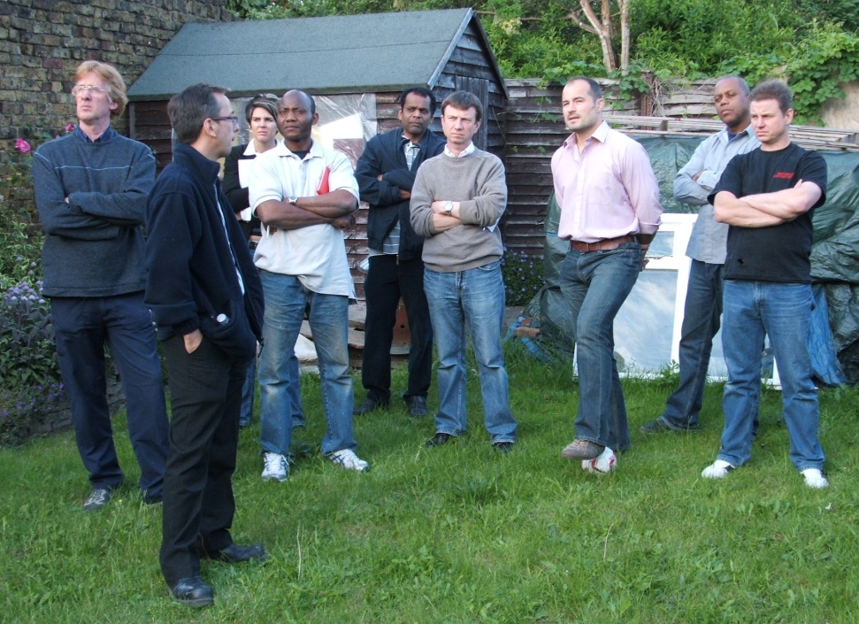
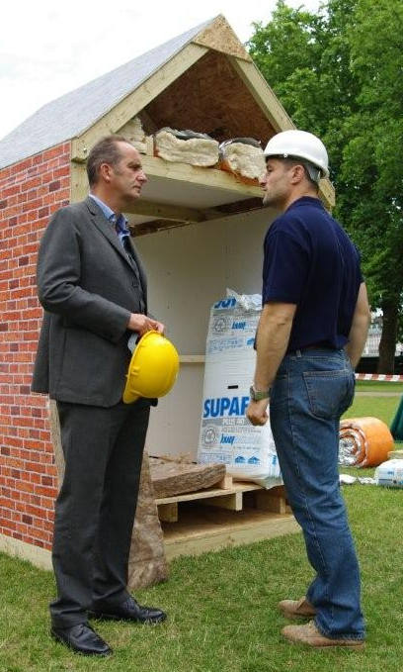
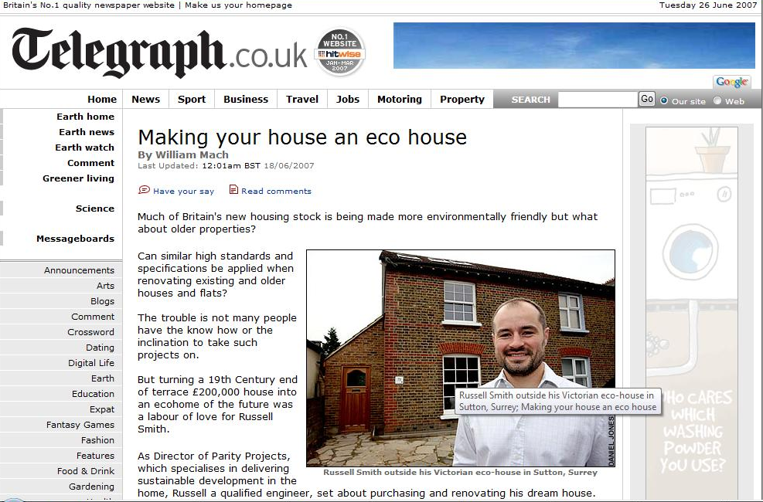





Winners of Building Magazine's 2007
Award for Sustainable Refurbishment
Notes:
3

Slide 4


Our recent CV
Individual “Masterplan” assessment of over 1200+ homes
Project managers of domestic retrofits
“CROHM” stock assessments covering 2m+ properties
Training 100s of SMEs on retrofit theory & practice
Member of various Gov’t working groups including Green Construction Board
Fellow of Retrofit Academy
Founded RetrofitWorks
Notes:
4

Slide 5
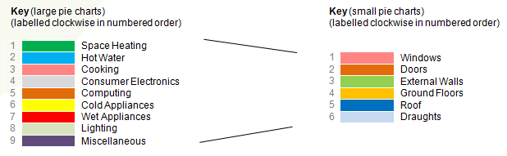
The basics

Slide 6
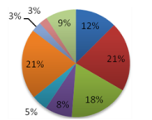
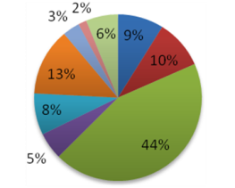
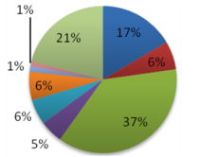
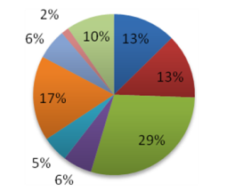
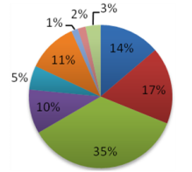
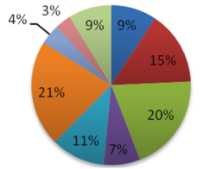
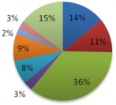
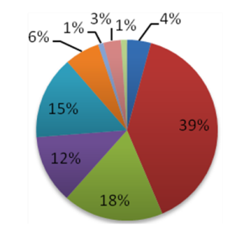
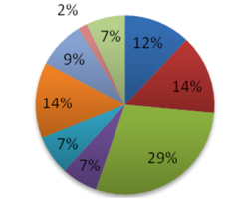
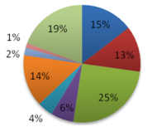
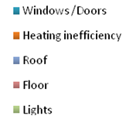
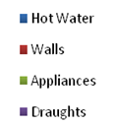
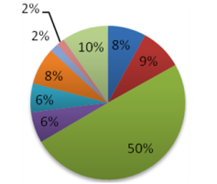
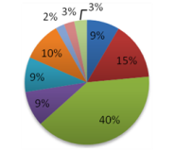
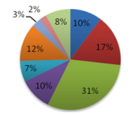
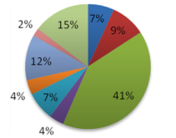
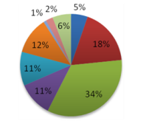
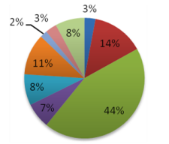
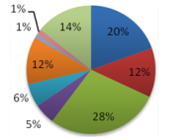
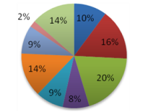
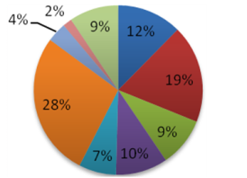
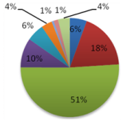
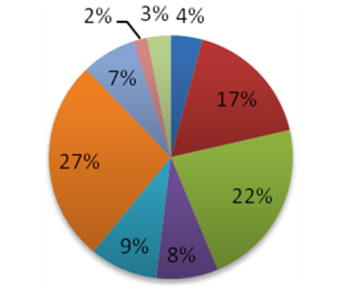
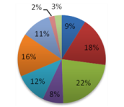
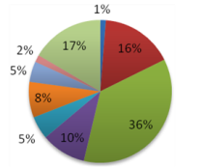
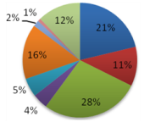
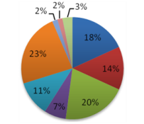
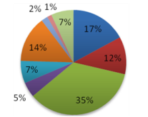
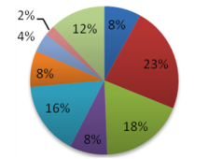
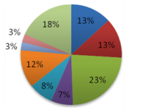
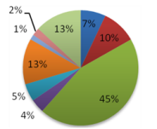
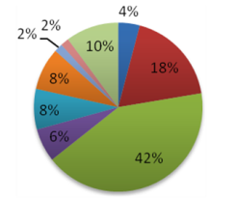
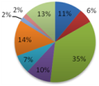
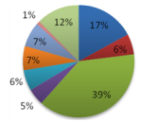
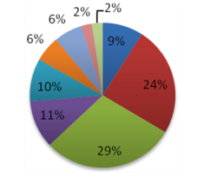
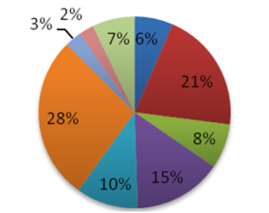
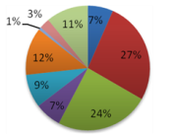
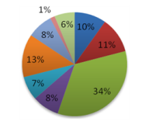
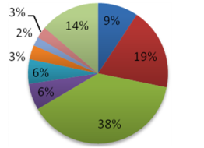
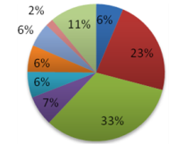
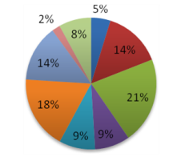
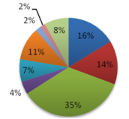
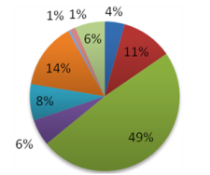
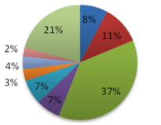
Every home is unique

Slide 7
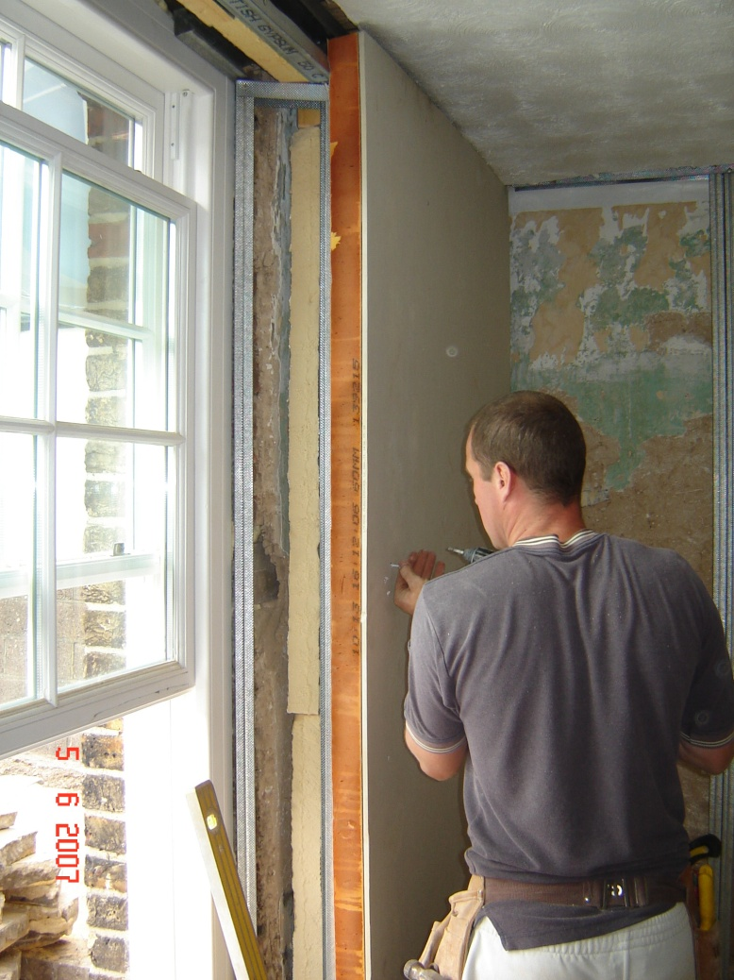
Motivating Concurrent Working
A Whole House Plan

Slide 8
‘whole stock’ plan?

Slide 9

Systematising decisions:
ECO had us all chasing the money…
.
No data, uninformed decisions, no confidence.

Slide 10
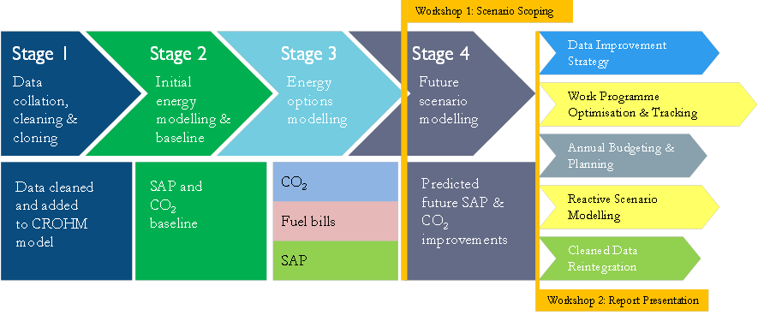
CROHM Process
Notes:
3. Business as usual

Slide 11





1. Data
Full RdSAP data for each property?
Other data sources:
    Boiler records
    Stock condition surveys
    Schedules of works
    Etc.
    Etc.
Notes:
You will have far more information that you first think. Nobodies data cannot be improved and no-ones data is as bad as they think.
Even EPC data goes is historic the moment you walk out the door.

Slide 12


2. Baseline
Calculate RdSAP scores

Slide 13


2. Baseline
Cut and dice by:
  Property type
  Age
  Location (with GIS mapping)

Slide 14
2. Baseline

Slide 15
Where do planned works get you?
  Boiler replacement and maintenance
  Planned Maintenance
  Major works
  Voids
How far are future plans?
3. Programme Modelling

Slide 16

3. Programme Modelling

Slide 17
4. GAP analysis
EPC recommendations:
- Static prices
- Defined measures order
- Limited number of recommendations
Most cost effective way to get to your standard:
Additions to planned works
Integrated programmes reduce overall cost
Changes to planned works
Speeding up planned works
Funding – how can this be leveraged

Slide 18

4. GAP analysis

Slide 19

4. GAP analysis
Notes:
Are these special treatment or disposal / demolition

Slide 20
Presenting the results:

Slide 21



Presenting the results:

Slide 22
Systematising decisions:
Health
Fuel poverty
Comfort
Control
Asset value
Data cleansed? Data strategy?

Slide 23
Health:
Damp, Mould
  Moulds produce allergens, irritants and, sometimes, toxic substances. Inhaling or touching mould spores may cause an allergic reaction, such as sneezing, runny nose, red eyes and skin rash. Moulds can also cause asthma attacks.
Under-heating
  NICE: increase in death rates due to a drop in temperature varies across England but can happen when temperatures drop below about 6°C
  Home heating and insulation interventions to households where someone has chronic obstructive pulmonary disease, heart disease or is older than 65 was found to be cost effective from the perspective of the health sector.
  Office for National Statistics:
    18,200 excess winter deaths occurred in England and Wales in 2013/14 – the lowest number of excess winter deaths since records began in 1950/51
    The majority of deaths occurred among those aged 75 and over; there were an estimated 14,000 excess winter deaths in this age group in 2013/14 compared with 4,000 in people aged under 75.
Over-heating
  2003 heatwave in northern France when temperatures soared above 40 ˚C, resulting in the deaths of 15,000 people.
Notes:
NICE – National Institute for Health and Care Excellence
Damp – one of the biggest problems with existing housing.
[REDUCE CONTENT ON SLIDE]

Slide 24
Raising the bar
Data at the heart
Accurate predictions - commitments?
Diagnosing problems:
  Equipment or fabric underperforming?
  Lifestyle of occupant not as modelled
Forecasting problems:
  Trends in condition
  Proactive maintenance
Reduce uncertainties – encourage investment

Slide 25













Orsis Monitoring Solution
GPRS Network
Innovation in Smart Metering
ORSIS (UK) LIMITED
10 CARDALE PARK
BECKWITH HEAD
HARROGATE
NORTH YORKSHIRE
HG3 1RY
T: +44 (0) 1423 530700
www.orsis.co.uk
Notes:
Gareth

Slide 26








EnergyDeck Platform
HA/
Landlord
Residential
User
User dashboard
Portfolio benchmarking
Innovation in Smart Metering
Projects
Analytics
Projects database
Consumption tracking
ORSIS (UK) LIMITED
10 CARDALE PARK
BECKWITH HEAD
HARROGATE
NORTH YORKSHIRE
HG3 1RY
T: +44 (0) 1423 530700
www.orsis.co.uk
Notes:
Jack

Slide 27




EnergyDeck User Interface
Designed specifically for domestic market
User workshop with East Midlands Homes
Notes:
Jack

Slide 28

Parity’s CROHM Live
As RdSAP sees it:

Slide 29

Parity’s CROHM Live
As RdSAP models it:

Slide 30

Parity’s CROHM Live
C-Live extra inputs:

Slide 31

Parity’s CROHM Live
C-Live model:

Slide 32
Some current results:
just RdSAP
Notes:
Dave
[This and the following 5 slides are meant to appear as 1, but I couldn’t face the task of making the PowerPoint animations work]

Slide 33
+ Met Office data

Slide 34
+ Hot Water

Slide 35
+ actual electricity for gains

Slide 36
+ Internal ˚C
Notes:
## LAST OF SEQUENCE ##

Slide 37
Energy-related issues
Health
  Planning for health improvements
  Predicting health problems
  Guaranteeing improvements?
Asset value
  Link between energy performance and asset value not yet established – but with risk significantly reduced, the link is established

Slide 38
Thank you
Russell Smith, Managing Director
russell.smith@parityprojects.com
0208 874 6433

